Slide 1
Collection Framework
The Collections Framework provides a well designed set of INTERFACES and CLASSES for storing and manipulating groups of data as a single unit, a collection.

Slide 2
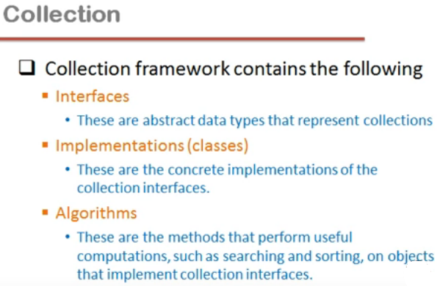

Slide 3
Revising interfaces
interface I1
{
void f1( );
void f2( int a);
}
class A implements I1
{
public void f1( )
{
------
}
public void f2( int a)
{
-----
}
}
Note:
All member functions of interface are public by default. So it is must to use public keyword while defining them in the class

Slide 4
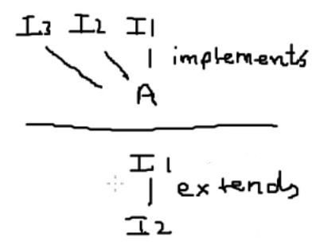
Important:
class implements interfaces
interface extends interface
As per the given example if any class implements I2 interface then it will defines all the functions of I2 interface and as well as of interface I1.
i.e. if interface I1 has 2 functions and I2 has 3 functions then class will implement 5 functions in total.

Slide 5

WHY Collection Framework ?
int a, b, c, d, e………. N number of variables
Int a [ ] = new int [100];
But Array has some limitations:
    Identical data
    Size
    Operations
        insert
        extract
        remove
        sort
        search

Slide 6
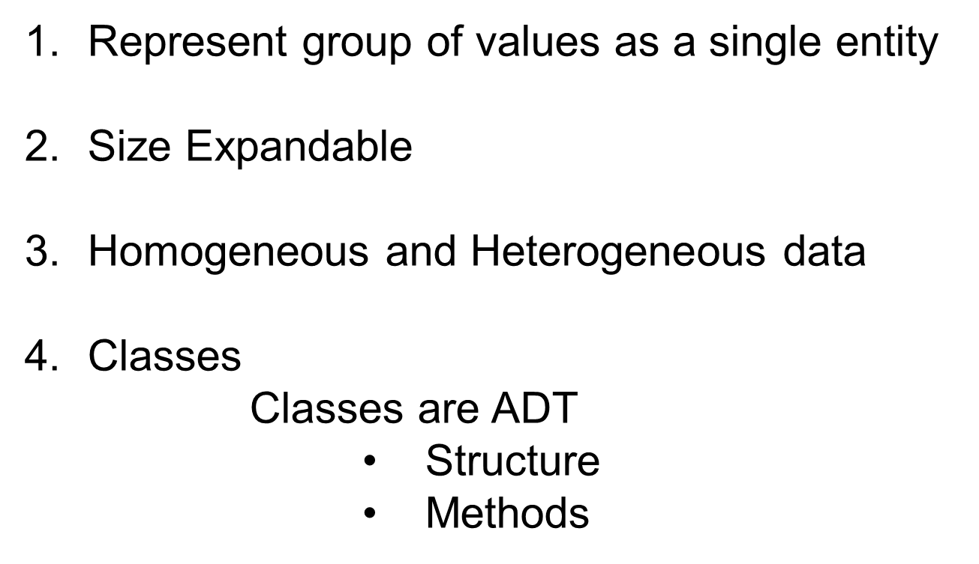
Advantages of Collection Framework

Slide 7
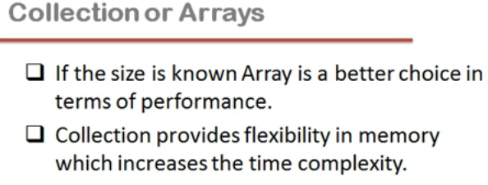

Slide 8
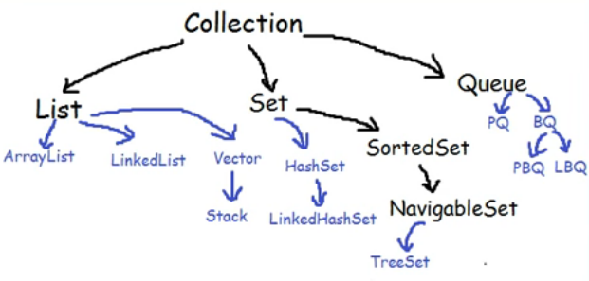
Note:
Black Text represents: Interfaces
Blue Text represents: Classes

Slide 9
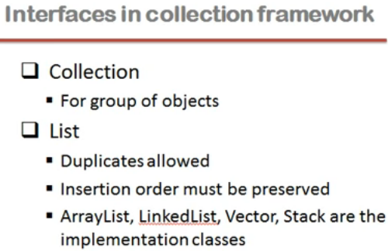

Slide 10
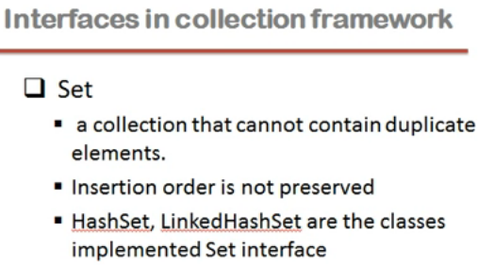

Slide 11
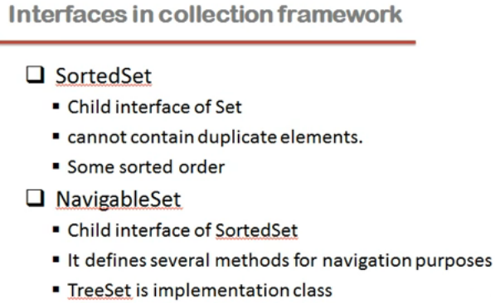

Slide 12
ArrayList l = new ArrayList( 4 );
l.add (A);
l.add (B);
l.add (C);
l.add (A);
0 | 1 | 2 | 3
A | B | C | A

Slide 13
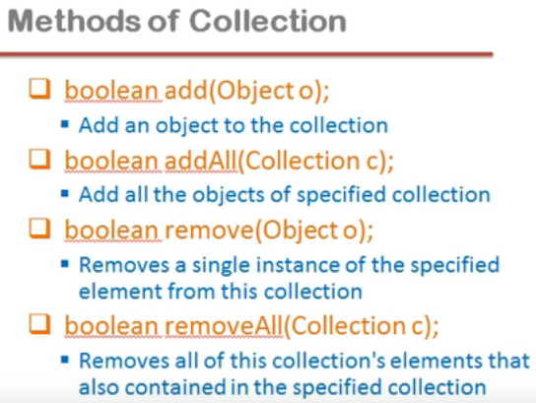

Slide 14
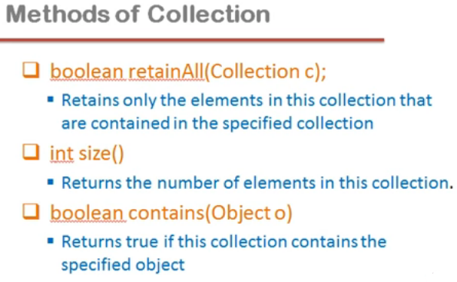

Slide 15
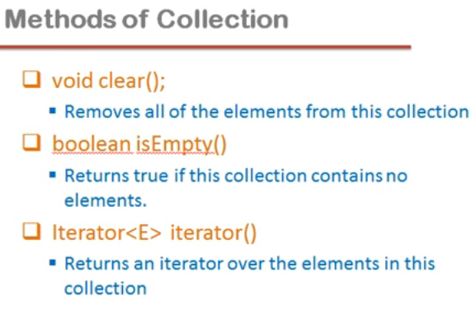

Slide 16
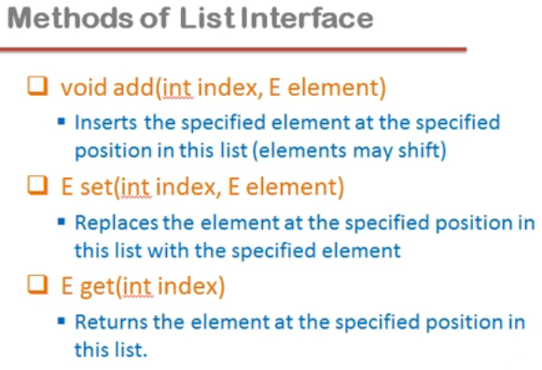

Slide 17
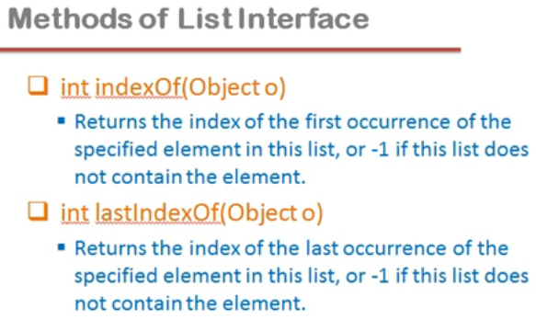

Slide 18
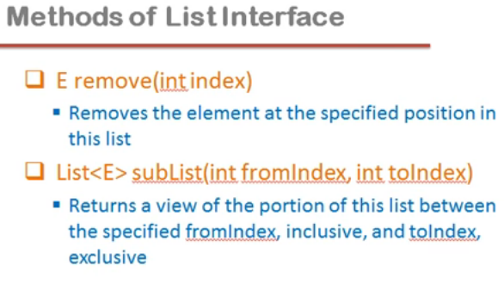

Slide 19
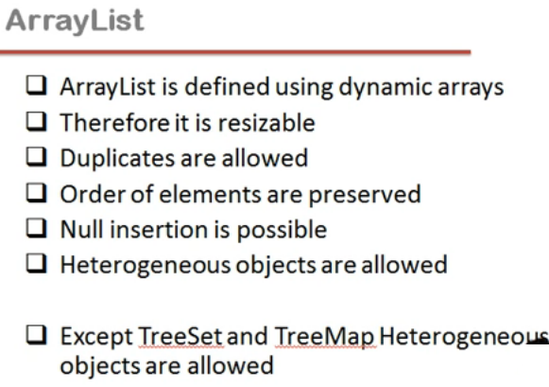

Slide 20
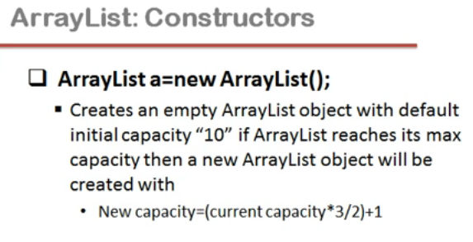

Slide 21
